Slide 1
Capstone Engagement
Assessment, Analysis, and Hardening of a Vulnerable System

Slide 2
Table of Contents
This document contains the following sections:
01
Network Topology
02
Red Team: Security Assessment
03
Blue Team: Log Analysis and Attack Characterization
Hardening: Proposed Alarms and Mitigation Strategies
04

Slide 3
Network Topology
‹#›

Slide 4
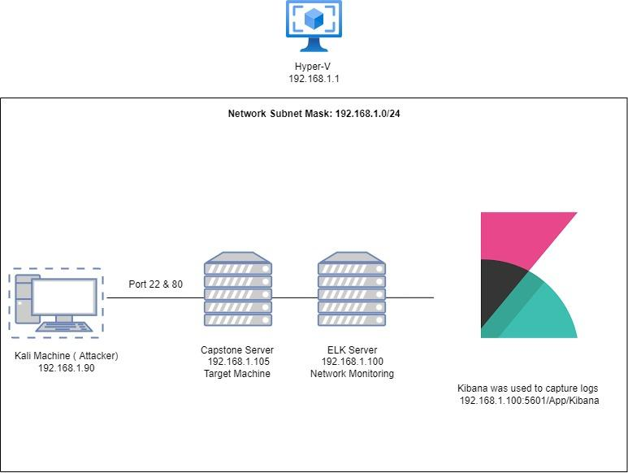
Network Topology
Network
Address Range:192.168.1.0/24
Netmask: 255.255.255.0
Gateway:192.168.1.1
Machines
IPv4:192.168.1.1
OS:Windows
Hostname: HyperVisor
IPv4:192.168.1.90
OS:Linux Kali
Hostname:Kali
IPv4:192.168.1.100
OS:Linux Ubuntu
Hostname:ELK
IPv4:192.168.1.105
OS:Linux
Hostname:Capstone

Slide 5

Red Team
Security Assessment
‹#›

Slide 6
Recon: Describing the Target
Nmap identified the following hosts on the network:
Hostname | IP Address | Role on Network
Hyper-V | 192.168.1.1 | Cloud Based Host Machine
Kali | 192.168.1.90 | Kali Attack Machine
ELK Stack | 192.168.1.100 | Network Monitoring Machine
Capstone | 192.168.1.105 | Target Machine

Slide 7
Vulnerability Assessment
The assessment uncovered the following critical vulnerabilities in the target:
Vulnerability | Description | Impact
Weak Password/Non-Salted Hashes | Short, common, a system default, or something that could be rapidly guessed by executing a brute force attack | If an attacker can gain access to the hashes, then the lack of a salt makes it easier to conduct brute force attacks
LFI Vulnerability | LFI allows access into confidential files on a site. | An LFI vulnerability allows attackers to gain access to sensitive credentials
CVE-2017-7269 | WebDAV improperly handles objects in memory, which could allow an attacker to run arbitrary code on the user’s system. | An attacker who successfully exploited this vulnerability could gain the same user rights as the current user (root accessibility).
Unrestricted Upload of File with Dangerous Type | Unrestricted Upload of File with Dangerous Type | Allows the attacker to upload or transfer files that can be automatically processed within the product's environment.

Slide 8
Vulnerability Assessment
The assessment uncovered the following critical vulnerabilities in the target:
Vulnerability | Description | Impact
CVE-2019-6579 | An attacker with network access to the web server on port 80/TCP or 443/TCP could execute system commands with administrative privileges. | No user interaction is required to exploit this security vulnerability. Successful exploitation of the security vulnerability compromises confidentiality, integrity or availability of the targeted system.
Exposure of Information Through Directory Listing | A directory listing is inappropriately exposed, yielding potentially sensitive information to attackers. | Exposing the contents of a directory can lead to an attacker gaining access to source code or providing useful information for the attacker to devise exploits, such as creation times of files or any information that may be encoded in file names. The directory listing may also compromise private or confidential data.

Slide 9
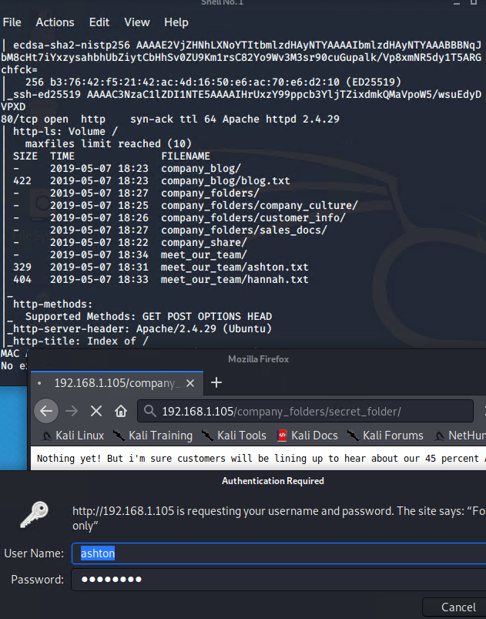
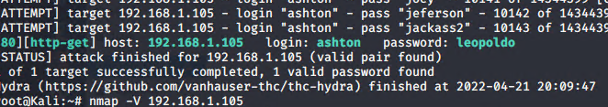
Exploitation: Exposure of Information Through Directory Listing
01
02
03
Tools & Processes
NMAP- scanned the network and discovered the apache server, files and open ports (22,80) nmap -A -vvv 192.168.1.105
BROWSER-Used the browser to navigate to the IP address and look through the available
folders
HYDRA-used to crack the password hydra -l ashton -P /usr/share/wordlists/rockyou.txt -s 80 -f -vV 192.168.1.105 http-get /company_folders/secret_folder
Achievements
This exploit revealed
usernames and clues as to
who had admin rights to
specific folders.
Discovered a secret_folder in the customers.txt file
Gained access to
another user’s hashed
password after successfully logging in as Ashton

Slide 10
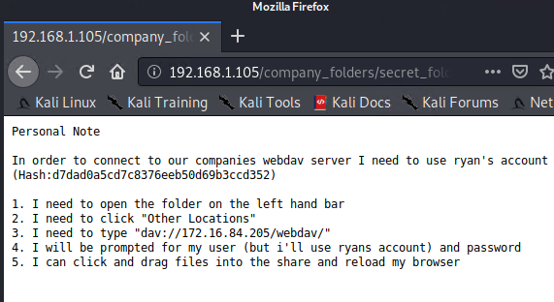
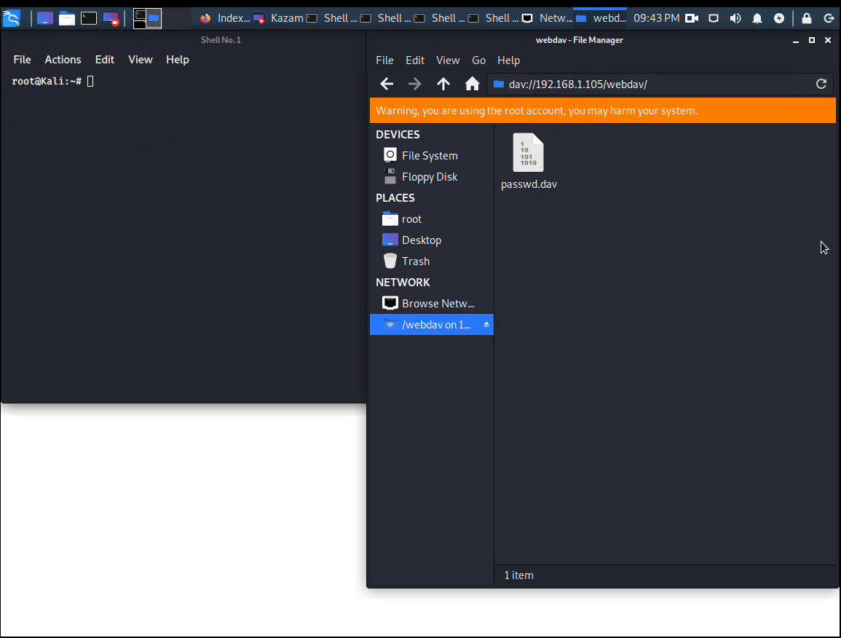
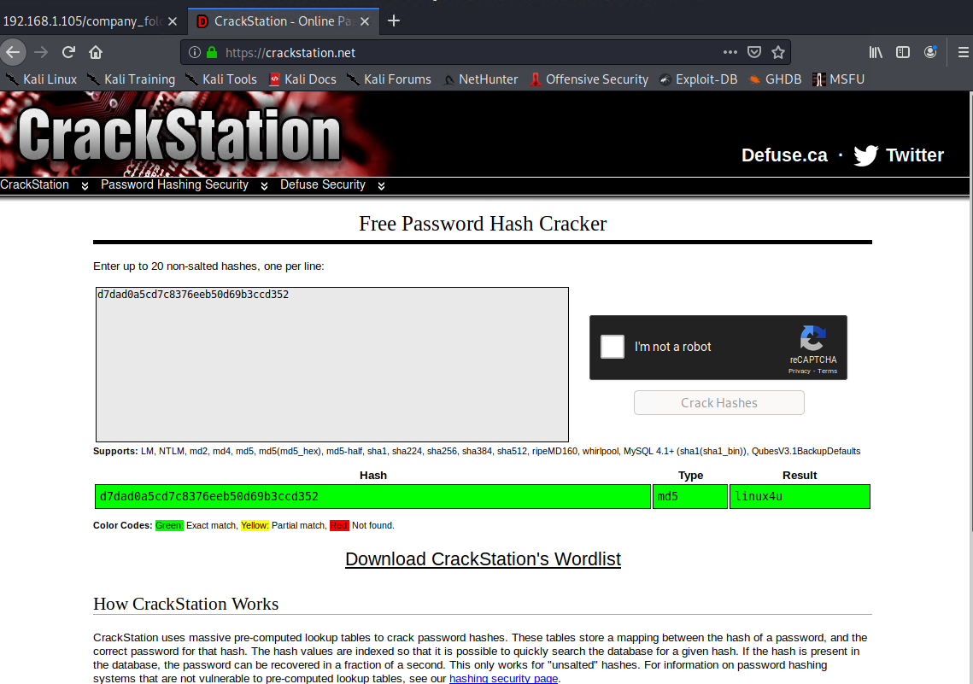
Exploitation: Hashed Passwords
01
02
03
Tools & Processes
I used CrackStation to
crack the hash
I used Ryan’s
credentials to access
the /WebDav folder
Created a listener on port 4444
Achievements
I gained root access to the companies webdav server

Slide 11
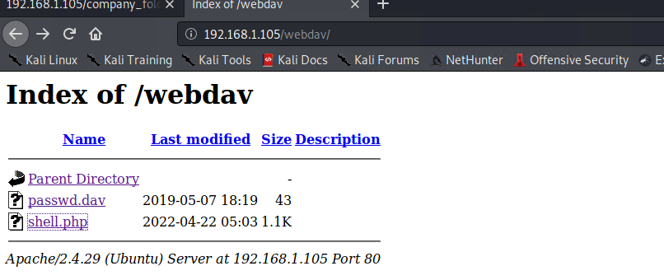
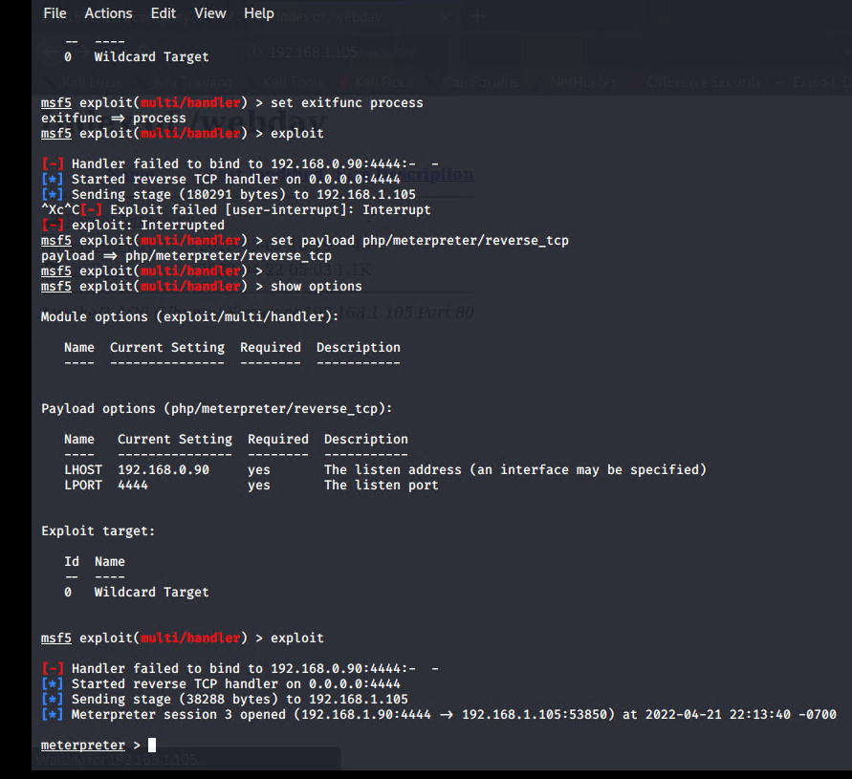
Exploitation: Unrestricted Upload of File with Dangerous Type
01
02
03
Tools & Processes
I was then able to upload
the PHP reverse shell
payload script
I was then able to execute the payload that I uploaded to the site to open up a meterpreter session
Achievements
Gained access through
reverse shell
Obtained highly
sensitive data

Slide 12

Blue Team
Log Analysis and Attack Characterization
‹#›

Slide 13
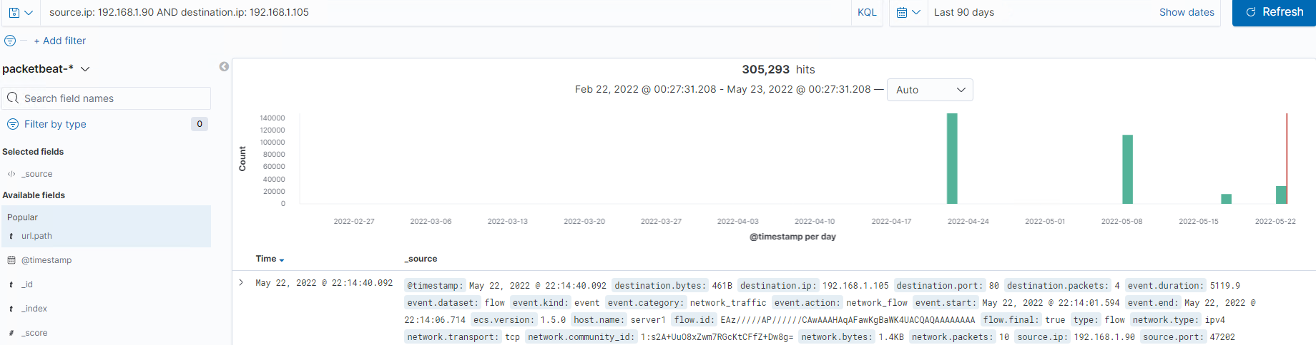
Analysis: Identifying the Port Scan
What time did the port scan occur? Apr 22, 2022 @ 03:00
How many packets were sent, and from which IP? 305,293 packets were sent from 192.168.1.90 (multiple attacks)
What indicates that this was a port scan? The high number of connections made between the attack and target machine

Slide 14
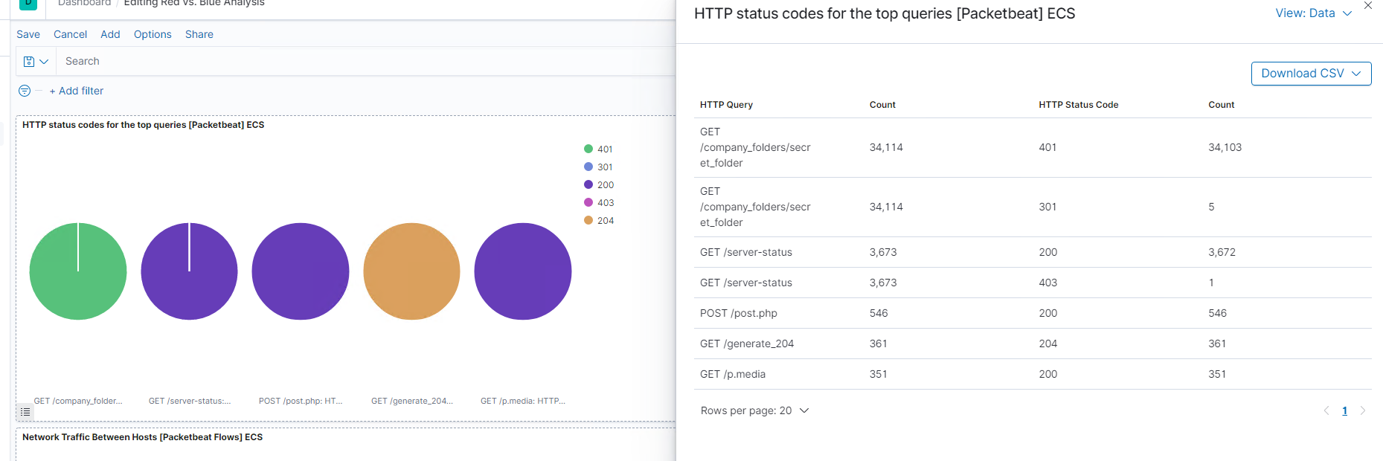
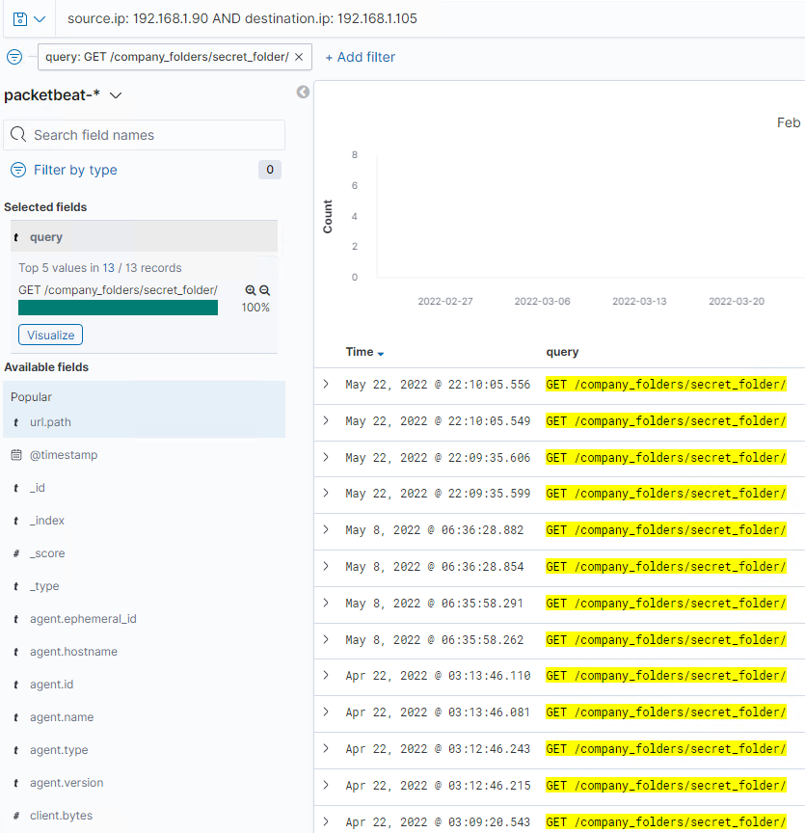
Analysis: Finding the Request for the Hidden Directory
What time did the request occur? How many requests were made? 03:10 & 34,103 request were made
Which files were requested? What did they contain? company_folders/secret_folder was requested. This file contained Ryan’s credentials, which would later be used to access the companies webdav server.

Slide 15
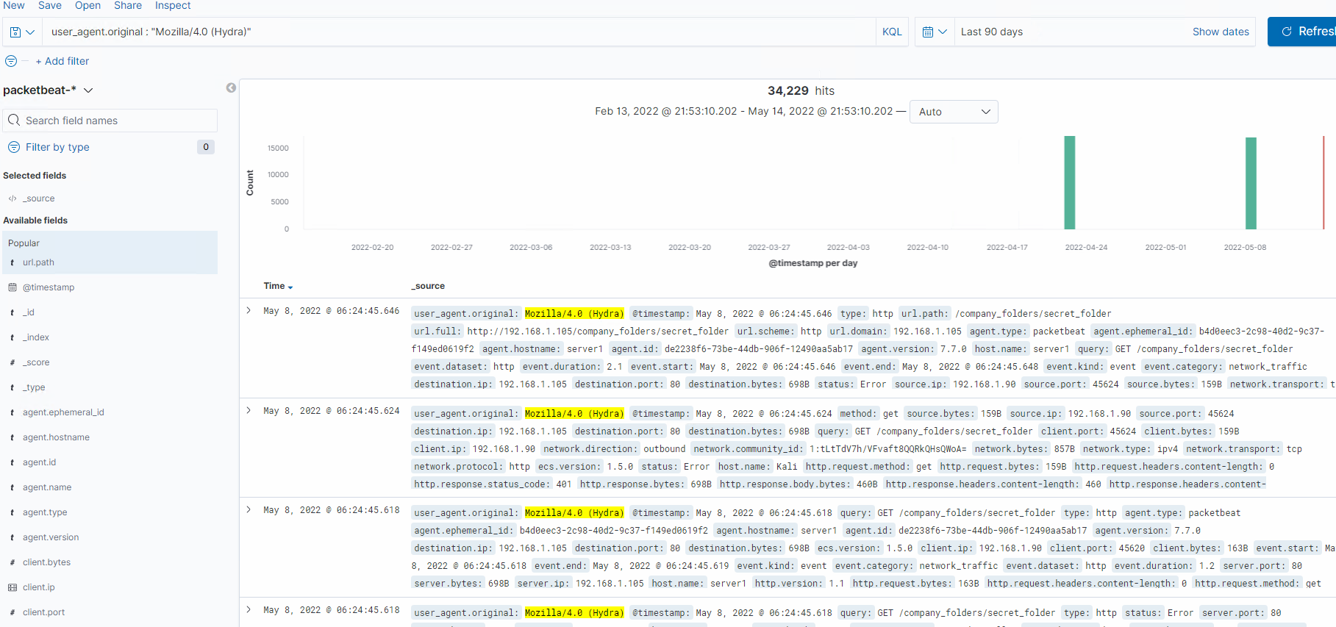
Analysis: Uncovering the Brute Force Attack
How many requests were made in the attack? 34,229
How many requests had been made before the attacker discovered the password? 34,228

Slide 16
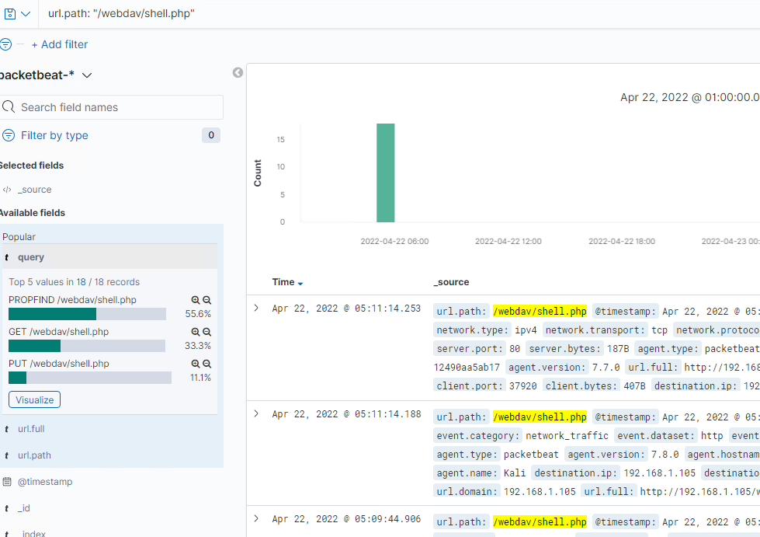
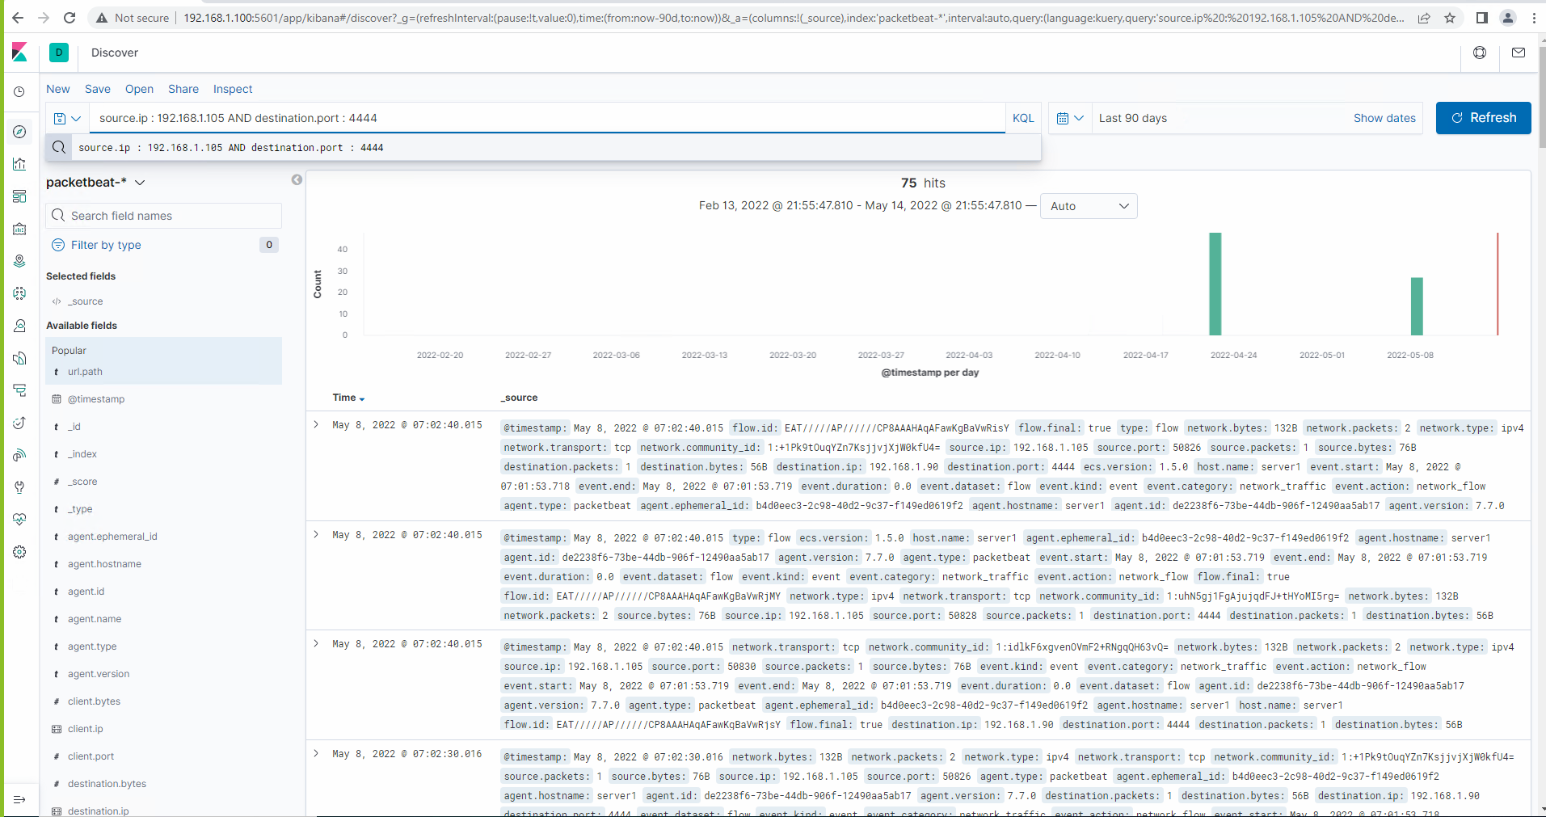
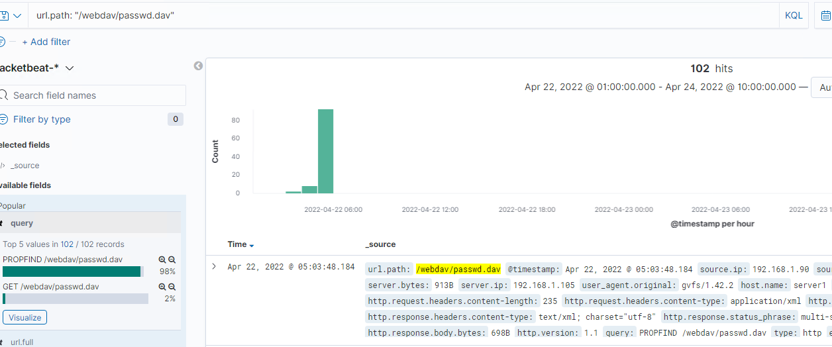
Analysis: Finding the WebDAV Connection
How many requests were made to this directory? Around 300 request
Which files were requested? 102 request were made to /passwd.dav & 166 request were made to /shell.php

Slide 17
Blue Team
Proposed Alarms and Mitigation Strategies
‹#›

Slide 18
Mitigation: Blocking the Port Scan
What kind of alarm can be set to detect future port scans?
Large amount of requests coming
from a single IP address over a period of time
What threshold would you set to activate this alarm?
10 requests per second from source IP
What configurations can be set on the host to mitigate port scans?
Unused ports can be closed, ignore any scans.
Describe the solution. If possible, provide required command lines.
Configure an IPS to block IP address if
requests exceed threshold
Notes:
Limit file types allowed to upload

Slide 19
Mitigation: Finding the Request for the Hidden Directory
What kind of alarm can be set to detect future unauthorized access?
If a connection is established from
an unauthorized source or machine
What threshold would you set to activate this alarm?
If this happens >1 time an alert should be triggered. This action should not be taken lightly
What configuration can be set on the host to block unwanted access?
Enforce access controls to a defined
security group of allowed users
using group policy
Describe the solution. If possible, provide required command lines.
Create whitelist with given IP’s and MAC addresses

Slide 20
Mitigation: Preventing Brute Force Attacks
What kind of alarm can be set to detect future brute force attacks?
Detect source IPs that are exceeding a high threshold of rejected and/or invalid logins
What threshold would you set to activate this alarm?
10 password failed attempts per minute
What configuration can be set on the host to block brute force attacks?
Block IP address when requests go
over threshold
Describe the solution. If possible, provide the required command line(s).
Passwords should be strong. Also, MFA is always beneficial

Slide 21
Mitigation: Detecting the WebDAV Connection
What kind of alarm can be set to detect future access to this directory?
Any unauthorized access to this folder with unfamiliar values such as: source ip, ports, etc. will trigger an alert
What threshold would you set to activate this alarm?
1 attempt could trigger this alert
What configuration can be set on the host to control access?
Allow only internal network to upload
files and documents
Describe the solution. If possible, provide the required command line(s).
Whitelist ports, machines and domains. Uploads/downloads for users can possibly be limited. Only Admin can perform upload/download privileges.

Slide 22
Mitigation: Identifying Reverse Shell Uploads
What kind of alarm can be set to detect future file uploads?
An alarm can be set to detect large file uploads
from restricted ports, machines or workgroups. Also, be alerted if any file has suspicious code and file extensions.
What threshold would you set to activate this alarm?
Once unrecognized
port or machine tries to communicate
repeatedly. Set upload limits for workgroups
and set an alarm if the threshold is exceeded.
What configuration can be set on the host to block file uploads?
This web server should only be allowed to
communicate with certain ports and specific machines. Any other ports and machines can be restricted.
Describe the solution. If possible, provide the required command line.
Limit the type of files available for upload

